Slide 1
Introduction to Computational Thermodynamics
Section 1.2
Numerical Methods

Slide 2
Introduction
In a course about computational thermodynamics, it’s important to have an idea of the numerical methods available
However, this is not a course on numerical methods – this discussion aims to be a brief overview of some of the methods and terminology you will encounter over the next few sessions

Slide 3
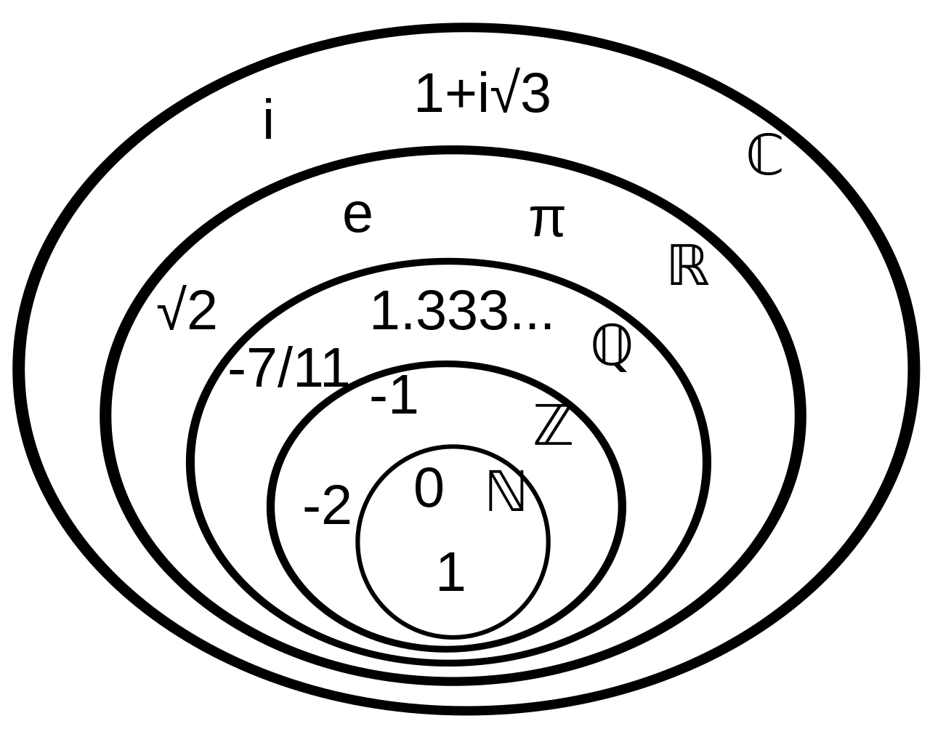
Mathematical Notation
Before getting into the numerical methods, we should review some definitions from multivariable calculus
A set is a collection of unique elements. There are a few common sets you should be familiar with
courtesy of Wikipedia
Notes:
There are a few sets you should be familiar with
First we have the natural numbers, which are positive integers. Then, we have the integers – denoted by Z. These are whole numbers, but can be negative. Beyond that is the rational numbers, followed by the real numbers, which is denoted by R. CHANGE

Slide 4

Mathematical Notation
Generally, everything in this course operates on the set of real numbers, denoted by $ℝ$
courtesy of Wikipedia
Notes:
Throughout this course we will almost always only be considering real numbers, as when dealing with thermodynamic properties it makes little sense to consider imaginary number

Slide 5
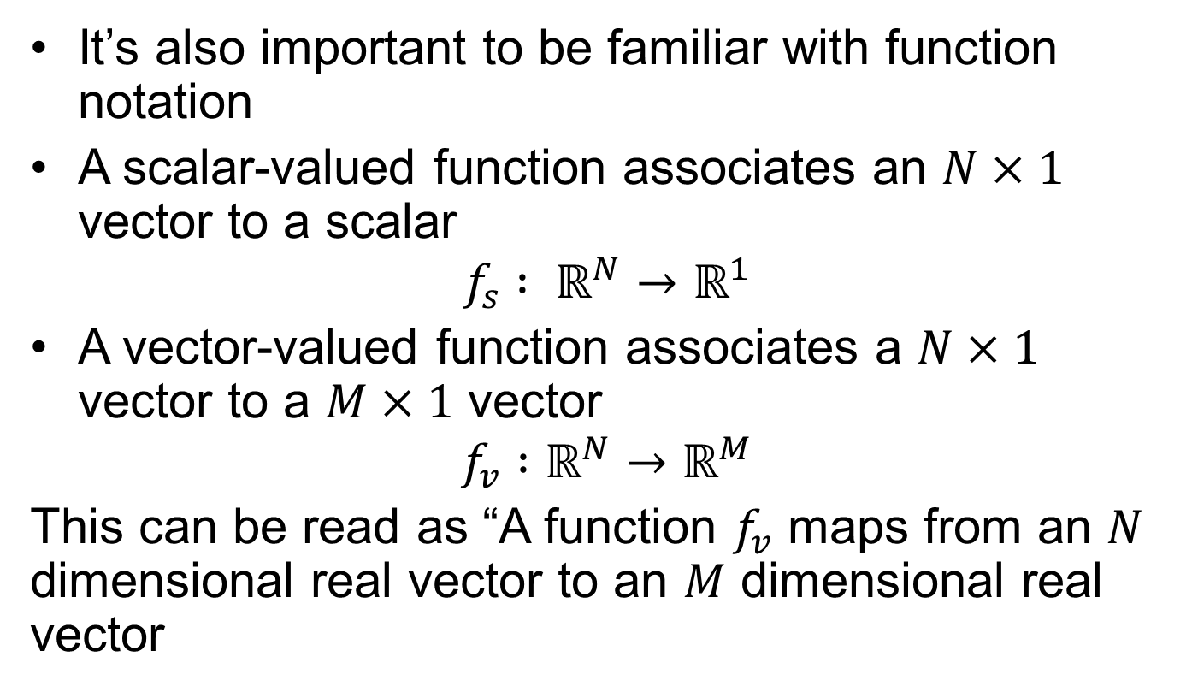
Mathematical Notation
It’s also important to be familiar with function notation
A scalar-valued function associates an $N×1$ vector to a scalar
$$f_{s} : ℝ^{N}→ℝ^{1}$$
A vector-valued function associates a $N×1$ vector to a $M×1$ vector
$$f_{v} :ℝ^{N}→ℝ^{M}$$
This can be read as “A function $f_{v}$ maps from an $N$ dimensional real vector to an $M$ dimensional real vector
Notes:
Moving beyond the basic sets, we now define functions on these sets.
By writing R to the power of N, we describe a N dimensional vector. For example, specifying the temperature distribution in a box would be a 3 dimensional scalar field.
This is written as a function, denoted f_s here, mapping from R^N to R^1.
We then consider vector fields, which map from an N dimensional vector to an M dimensional vector

Slide 6
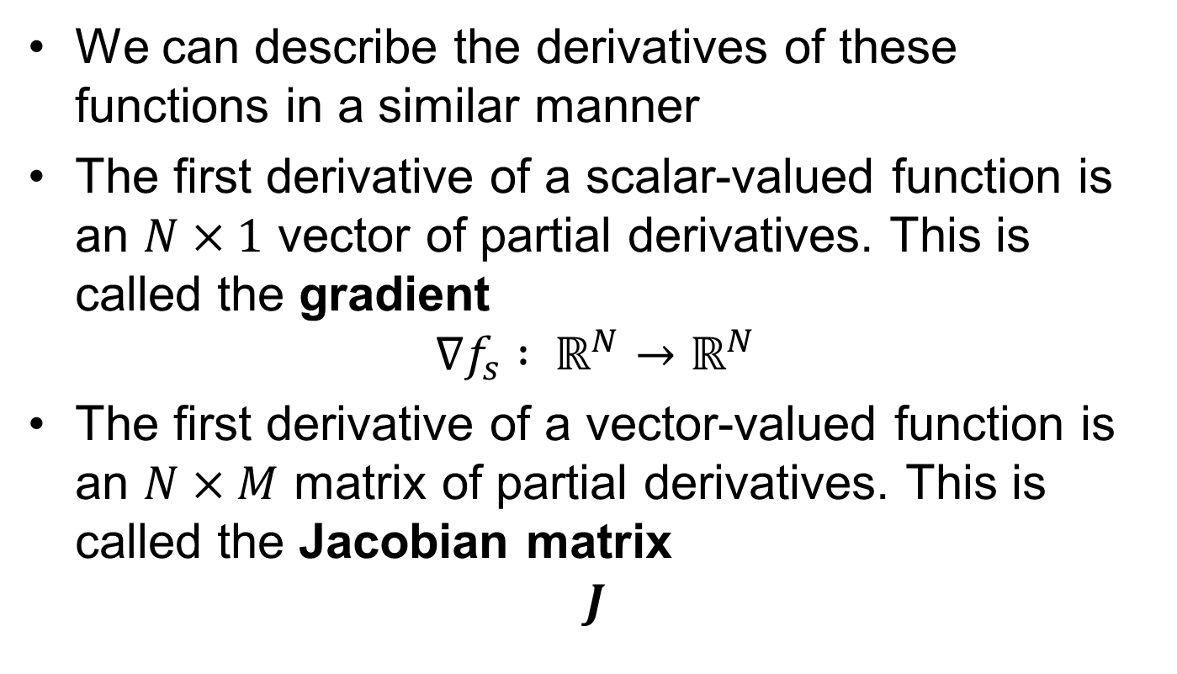
Mathematical Notation
We can describe the derivatives of these functions in a similar manner
The first derivative of a scalar-valued function is an $N×1$ vector of partial derivatives. This is called the gradient
$$∇f_{s} : ℝ^{N}→ℝ^{N}$$
The first derivative of a vector-valued function is an $N×M$ matrix of partial derivatives. This is called the Jacobian matrix
$$J$$
Notes:
The derivatives of these functions can be described in similar ways, so for a scalar function we define the gradient, nabla f_s, as mapping from an N dimensional vector to another N dimensional vector of partial derivatives.
For a vector function we describe the Jacobian matrix. The jacobian matrix is an NxM matrix of partial derivatives.

Slide 7
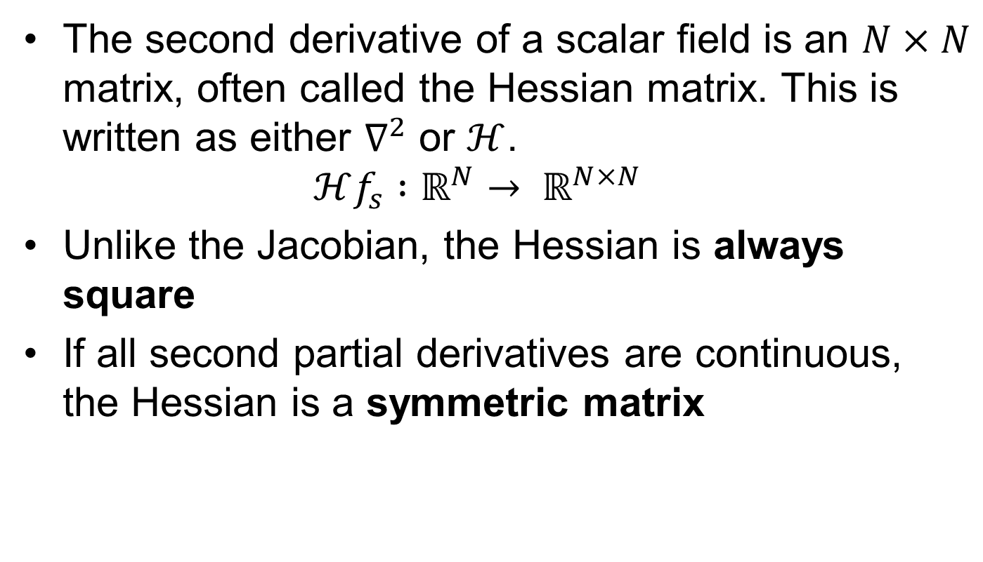
Mathematical Notation
The second derivative of a scalar field is an $N×N$ matrix, often called the Hessian matrix. This is written as either $∇^{2}$ or $ℋ$. $ℋf_{s} :ℝ^{N}→ ℝ^{N×N}$
Unlike the Jacobian, the Hessian is always square
If all second partial derivatives are continuous, the Hessian is a symmetric matrix
Notes:
The hessian is very important in optimisation, as it describes the second order derivative behaviour of a scalar field, which is often used in solvers.

Slide 8
Mathematical Notation
The second derivative of a vector-valued function is not often used on it’s own. Rather, operators like the curl and divergence of a vector field are considered.
These will not be used in this course
They are, however, very relevant to fields like fluid mechanics

Slide 9
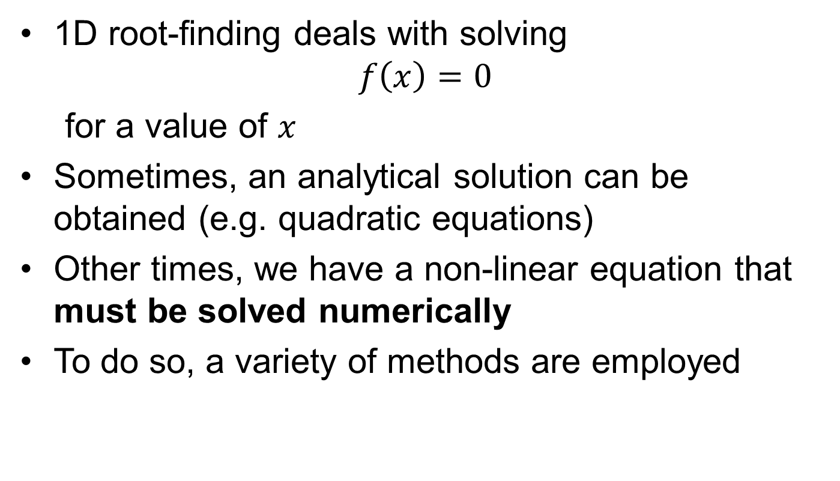
Root-Finding
1D root-finding deals with solving $f\left(x\right)=0$
for a value of $x$
Sometimes, an analytical solution can be obtained (e.g. quadratic equations)
Other times, we have a non-linear equation that must be solved numerically
To do so, a variety of methods are employed
Notes:
So, moving on from there, we now look at root finding. Root finding

Slide 10
Root-Finding
Although there are many different methods out there, we will focus on Newton’s method
Although first published in 1685, modified versions of this algorithm are used very frequently even at the cutting-edge of root-finding and optimisation
Notes:
Modern modifications to Newton’s method generally improve the convergence or the speed. A key example of improved convergence is with the addition of a line search, though this is outside the scope of what we will be looking at.

Slide 11
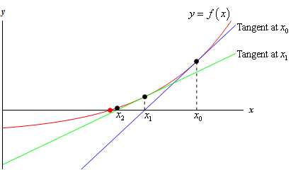
Newton’s method
Newton’s method, sometimes known as the Newton-Raphson method, repeatedly approximates the function by its tangent line
Notes:
Talk through the successive iterations and point out they move towards 0. We can see that were the function a straight line, Newton’s method would solve directly for the zero in a single iteration.

Slide 12
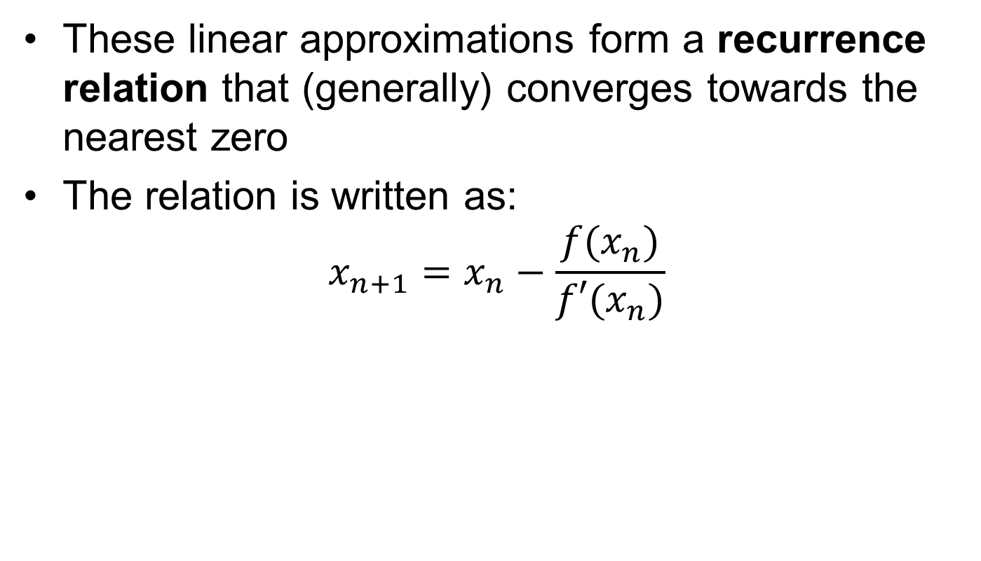
Newton’s method
These linear approximations form a recurrence relation that (generally) converges towards the nearest zero
The relation is written as:
$$x_{n+1}=x_{n}−\frac{f(x_{n})}{f′(x_{n})}$$
Notes:
A recurrence relation means a function defining the n+1th term based off of previous terms. So, for Newton’s method, we define x_n+1 in terms of the function and the first derivative evaluated at x_n

Slide 13
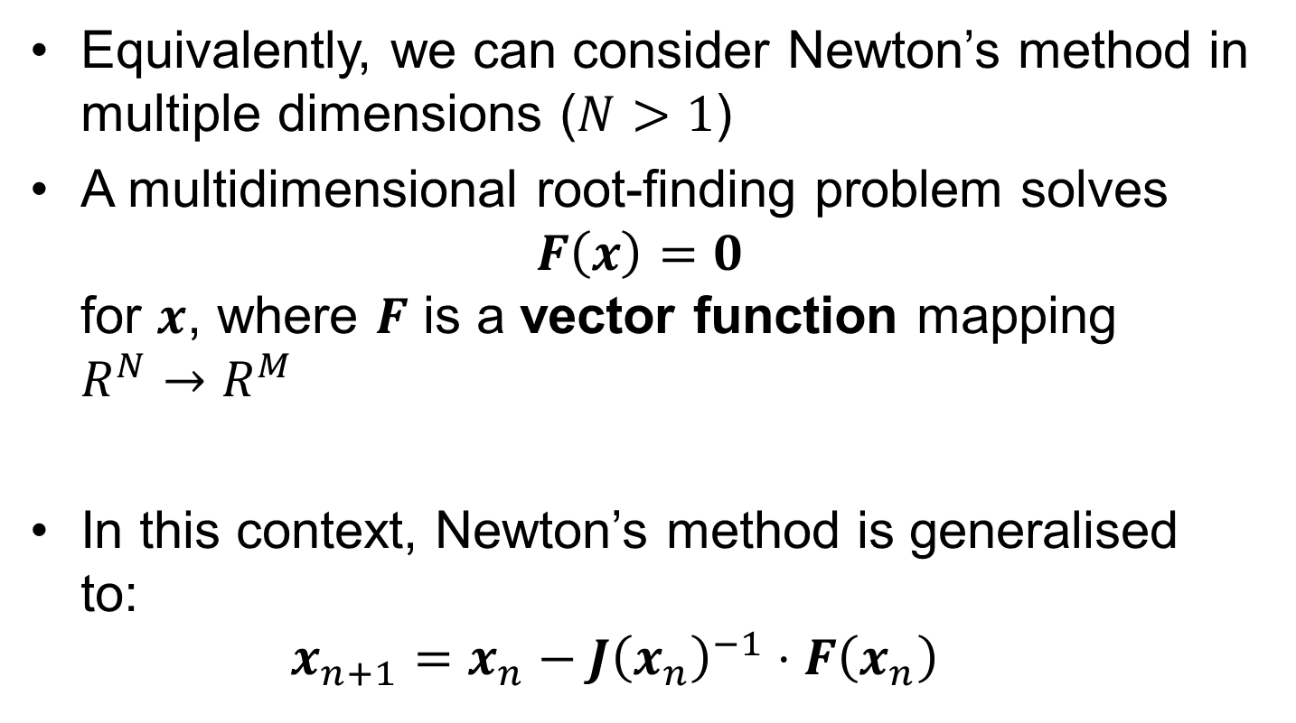
Newton’s method
Equivalently, we can consider Newton’s method in multiple dimensions ($N>1$)
A multidimensional root-finding problem solves $F\left(x\right)=0$ for $x$, where $F$ is a vector function mapping $R^{N}→R^{M}$
In this context, Newton’s method is generalised to: $x_{n+1}=x_{n}−J{\left(x_{n}\right)}^{−1}⋅F\left(x_{n}\right)$
Notes:
We can then generalise to multidimensional problems by considering a vector field given by F(x) = 0. We replace our first derivative with the Jacobian matrix, but otherwise this should look very similar to the expression on the previous slide.

Slide 14
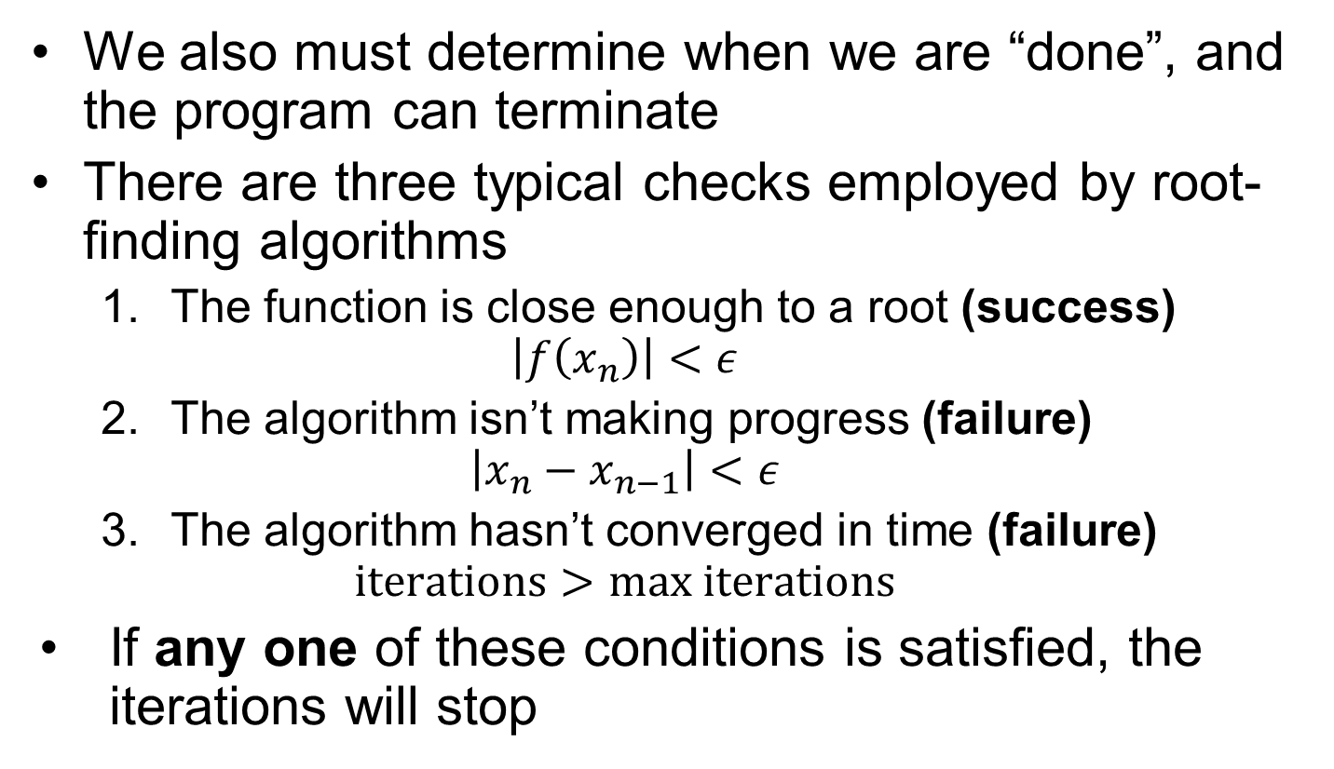
Convergence
We also must determine when we are “done”, and the program can terminate
There are three typical checks employed by root-finding algorithms
The function is close enough to a root (success) $\left|f\left(x_{n}\right)\right|<ε$
The algorithm isn’t making progress (failure) $\left|x_{n}−x_{n−1}\right|<ε$
The algorithm hasn’t converged in time (failure) $iterations>max iterations$
If any one of these conditions is satisfied, the iterations will stop
Notes:
When considering the implementation of a method onto a computer, we must add termination conditions – otherwise it will just loop forever.
The three typical checks performed by a root-finding algorithm are
When the function is close enough to a root, typically referred to as the absolute tolerance. When this is satisfied we generally declare our algorithm successful and
When the function is failing to make progress, or if a predefined maximum number of iterations has been used up, the problem is declared unsolved and will either be returned to the user with an error, or

Slide 15
Convergence Characteristics
Newton’s method is locally convergent
a “good enough” initial point is required for the method to arrive at a root successfully
Modifications do exist that allow for the method to become globally convergent
Describing these is beyond the scope of this course. The typical classes of modifications are
Line search
Trust region

Slide 16
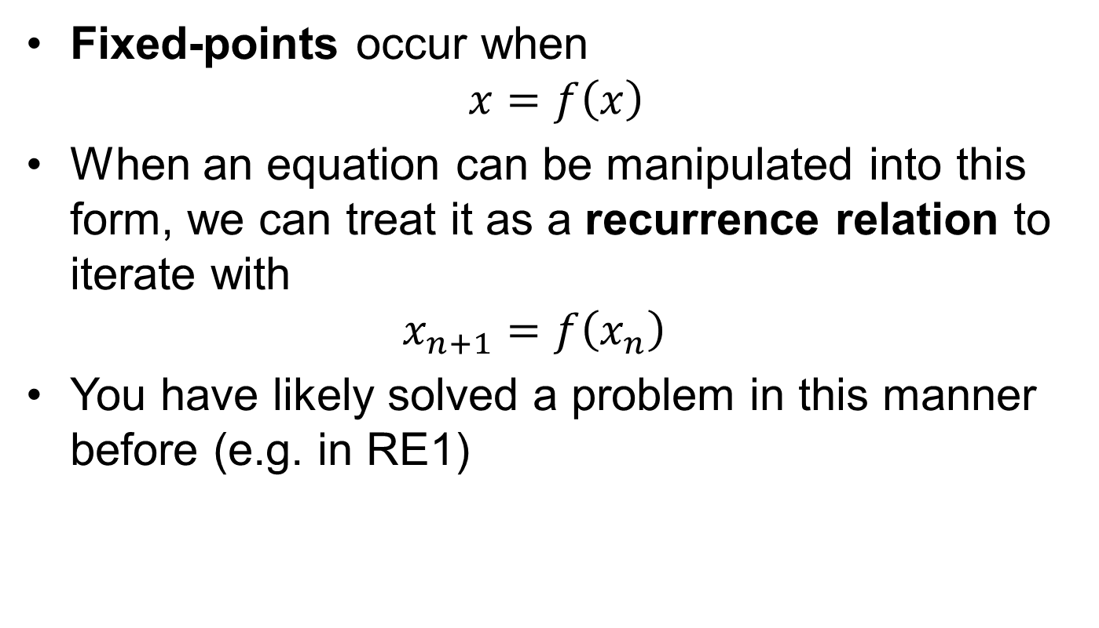
Fixed-points
Fixed-points occur when $x=f\left(x\right)$
When an equation can be manipulated into this form, we can treat it as a recurrence relation to iterate with $x_{n+1}=f\left(x_{n}\right)$
You have likely solved a problem in this manner before (e.g. in RE1)
Notes:
So, for example in the undergraduate reaction engineering 1 module, it was very common for us to iterate the extent or temperature to figure out the actual operating conditions of a reactor.

Slide 17
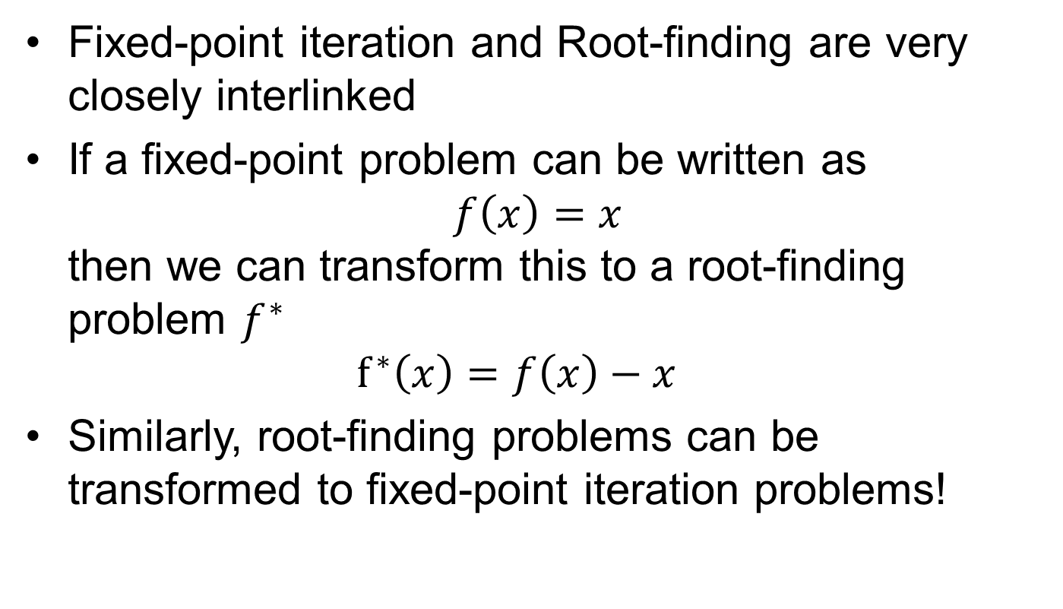
Fixed-points
Fixed-point iteration and Root-finding are very closely interlinked
If a fixed-point problem can be written as $f\left(x\right)=x$ then we can transform this to a root-finding problem $f^{∗}$ $f^{∗}\left(x\right)=f\left(x\right)−x$
Similarly, root-finding problems can be transformed to fixed-point iteration problems!
Notes:
So really the emphasis here is that you’ve seen both fixed point iteration and root-finding problems before, and trying to show that they are very closely interlinked, so you can transform a fixed-point iteration into a root finding problem, and sometimes it will work the other way too.

Slide 18
Optimisation
Optimisation algorithms attempt to solve for maximum and minimum points
It’s split into local and global optimisation
Local optimisation is equivalent to root-finding
Global optimisation is problem-dependent, and often very difficult

Slide 19
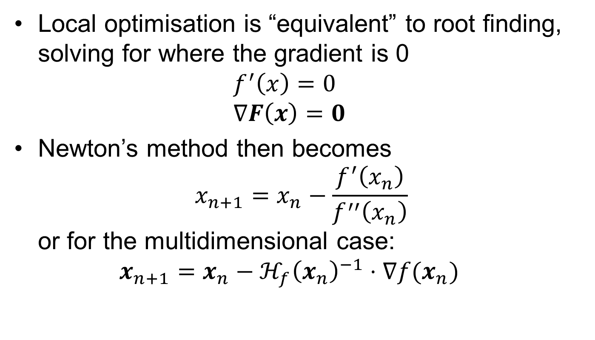
Optimisation
Local optimisation is “equivalent” to root finding, solving for where the gradient is 0 $f^{′}\left(x\right)=0$ $∇F\left(x\right)=0$
Newton’s method then becomes $x_{n+1}=x_{n}−\frac{f^{′}\left(x_{n}\right)}{f^{′′}\left(x_{n}\right)}$ or for the multidimensional case: $x_{n+1}=x_{n}−ℋ_{f}{\left(x_{n}\right)}^{−1}⋅∇f(x_{n})$
Notes:
A key part to note is that in this expression, a full inverse of the Hessian matrix is required. This is an expensive operation, and one of the key issues much research has previously aimed to resolve or improve,

Slide 20
Newton’s Method (Optimisation)
As this is applying Newton’s method to the first derivative, it is now approximating the function as locally quadratic, rather than locally linear.
Notes:
Because we are now approximating the first derivative as a linear function, what we are actually doing is assuming the function is locally quadratic. So, in the same way a linear function is solved in a single step of our root-finding Newton algorithm, a quadratic equation is solved in a single step of a Newton method aimed at optimisation

Slide 21
Convergence
As the minima of an optimisation problem is not known beforehand, we cannot use an absolute tolerance directly on the value of our objective function
Instead, convergence is often decided by testing the difference between successive iterations
An absolute tolerance can also be applied directly to the gradient of the objective function, should that be available.

Slide 22
Key Points
In root-finding, Newton’s method repeatedly approximates the function as linear until a zero is found
In optimisation, Newton’s method repeatedly approximates the function as quadratic until progress is no longer made

